Slide 1
'Spending and Revenue' for the city of San Francisco
Group 18
Group Members: Jiaqi Ling, Haoning Liu, Nupur Neti, Haofu Wu

Slide 2



Data Source Introduction
Maintained by The San Francisco Controller's Office
>550K transactions with 22 columns
New data added on a weekly basis, and available from fiscal year 2000 forward
Clean and tidy
UNIX commands, csvkit, Python, Star-Schema design, SQL, matplotlib, Tableau
Public accountability
Government self-appraisal

Slide 3

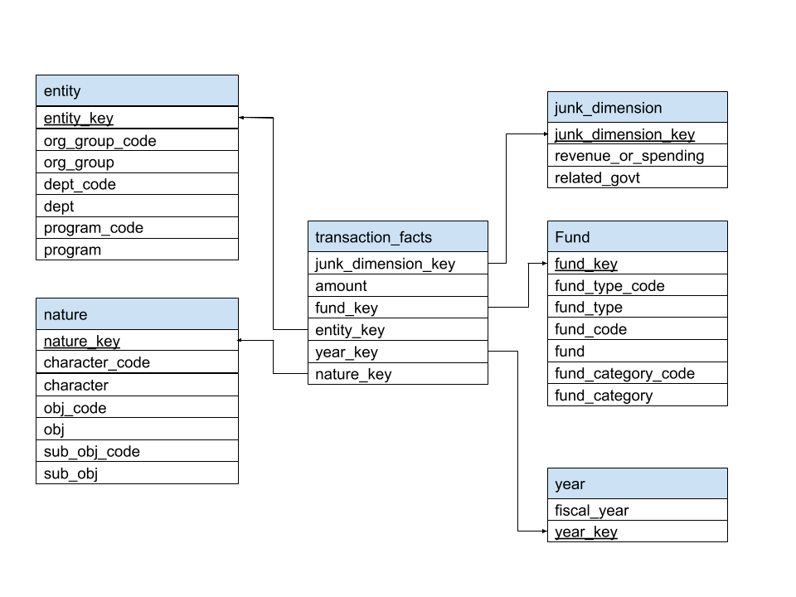
Star Schema

Slide 4

Concerned Questions
How has spending and revenue varied across the years?
Does the government keep a balance on budget and actual amount?
What is most of the money being spent on?
Which organization group spend the most amount of money?
What was the distribution of spending across characters?
Which funds are these amounts coming from?

Slide 5

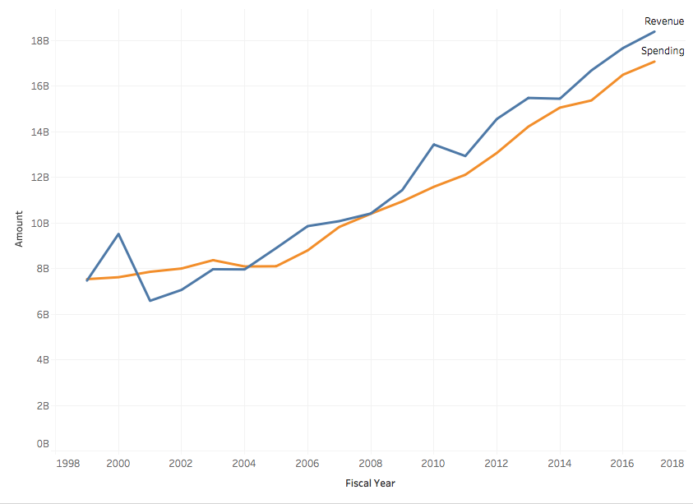
Revenue vs. Spending
The government has kept a balance of spending and revenue each year while the total amount has increased.
The overall revenue is higher than the overall spending, which is good for the continual operation.

Slide 6
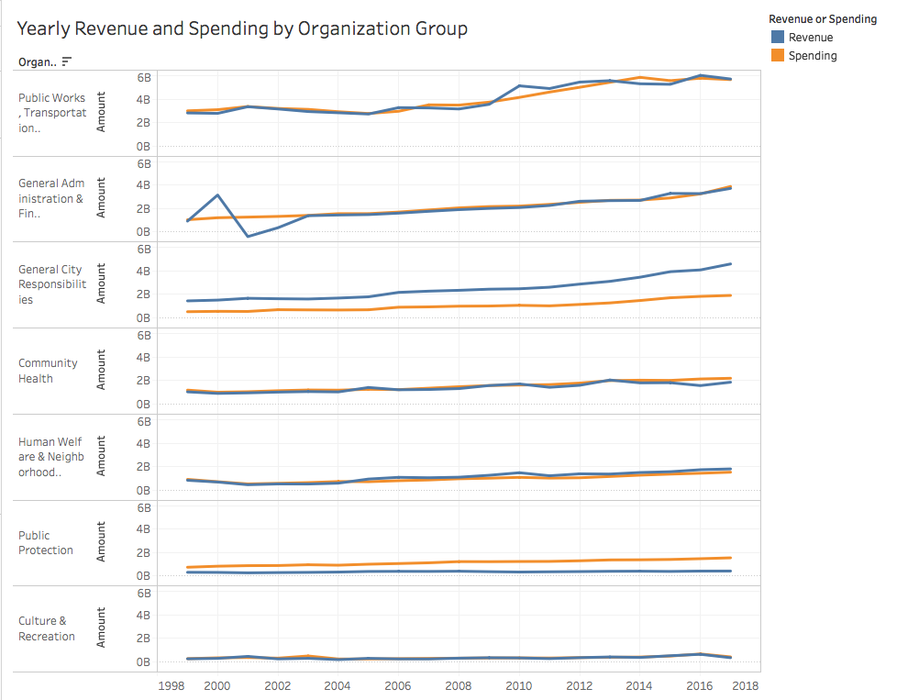
Dimension 1: Entity
Highest total spending and Highest total revenue: Public Works, Transportation & Commerce
Overall the revenue and spending is in balance for most organization groups.
Revenue of General City Responsibilities is always higher than its spending, while the spending of Public Protection is higher than its revenue over the years.
Dip in total 2001 revenue can be attributed to General Administration & Finance.

Slide 7
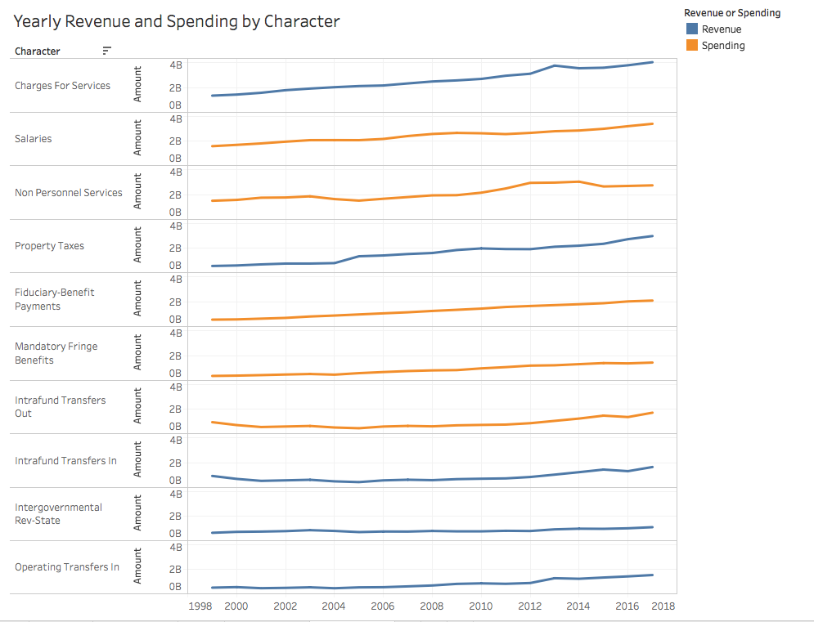
Dimension 2: Nature
Highest total spending
Salaries
Non Personnel Services
Fiduciary-Benefit Payments
Highest total revenue
Charges For Services
Property Taxes
Intrafund Transfers In
Character is accounting term specially designed for revenue and spending, so there is not much comparison between them.

Slide 8
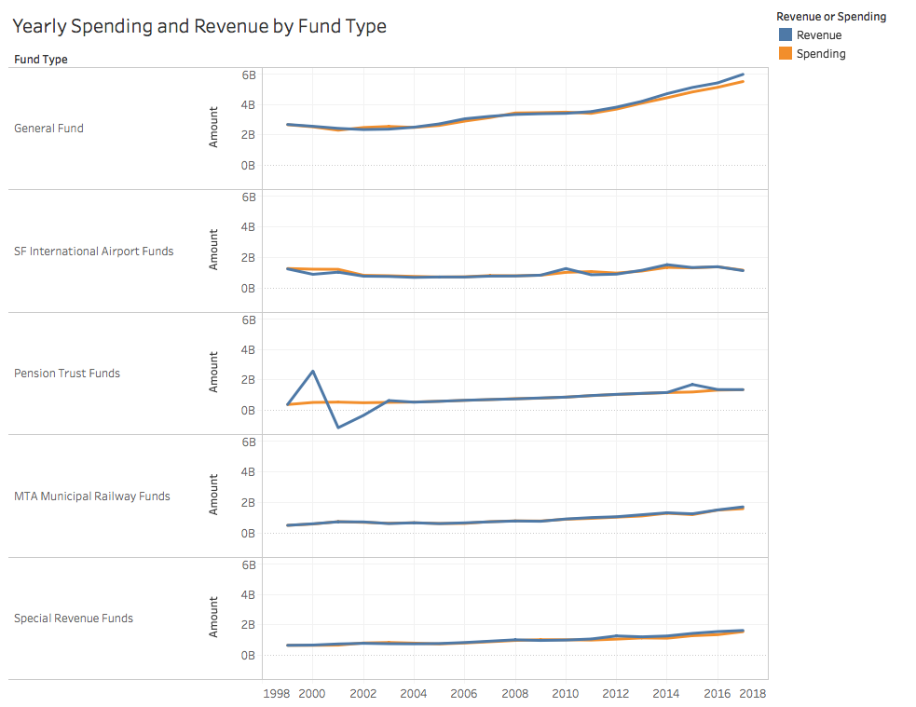
Dimension 3: Fund
Highest total spending
General fund (large proportion)
SF International Airport Funds
Pension Trust Funds
Highest total revenue
general fund
SF International Airport Funds
Pension Trust Funds

Slide 9
Dimension 3: Fund Cont’d
We can again see a dip in 2001.
We can also see that the dip in total 2001 revenue can be attributed to the dip in revenue from Pension Trust Funds.
Matching this with the dip in organisation Group General Administration & Finance
We can see that there could be some change in policy of Pensions Trust Funds within the General Administration & Finance organisation group

Slide 10
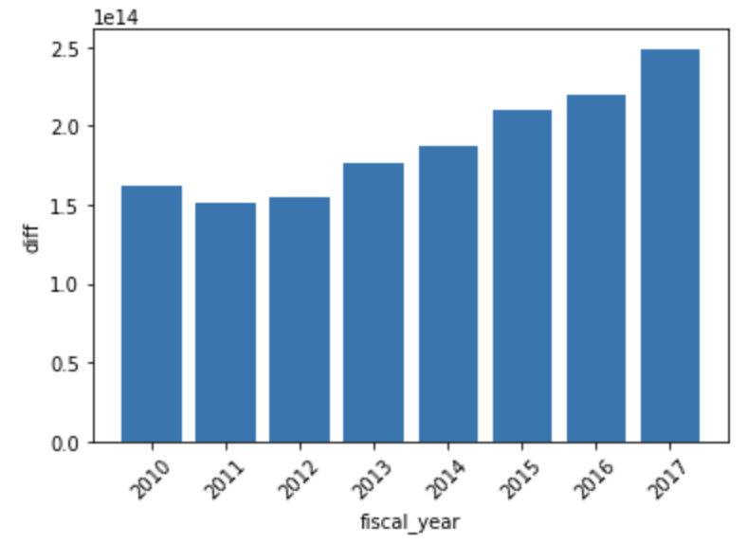
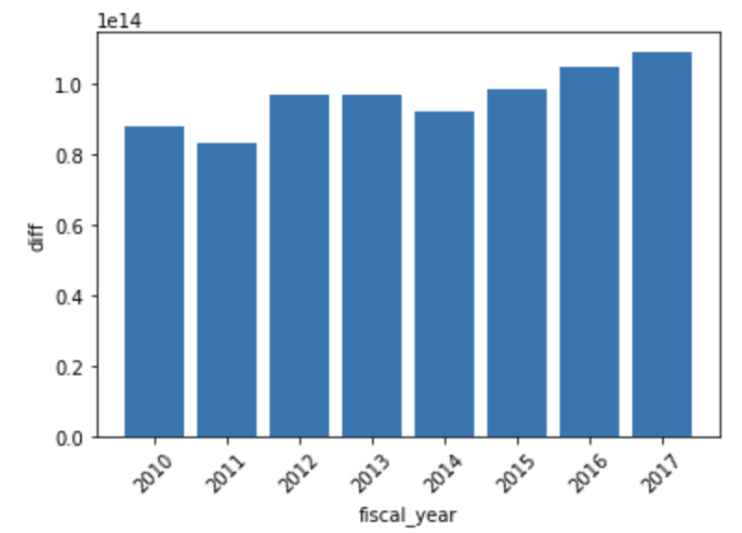
If we incorporate budget...
What if we compare annual spending and revenue with budget?
Possible reasons for the huge gap: Accounting adjustment? Surplus carried over years? Or just the prosperity of San Francisco?
Need further analysis with sufficient data.
Budget-Spending
Budget-Revenue

Slide 11
Thank you!

